Slide 1
Introduction to S-Tree
Huibo
July 2013

Slide 2
content
Abstract
Introduction
S-Tree cell design
S-Tree storage structure
S-Tree Operations
Performance
Applications based on S-Tree
Restrictions

Slide 3
Abstract
Spatio-temporal databases are becoming increasingly popular as the number of mobile devices equipped with GPS and Internet accesses grows
Relational database and some approaches proposed by others[5,9,10,12,13,14,15,17] are not fast enough for query
S-Tree is a structure that has high query efficiency while it cannot update

Slide 4
Introduction
S-Tree:
Is a hybrid structure that uses the quad-tree style space decomposition and a hash table for searching
Is very compact, allowing large spatial indexes to be stored in the main memory

Slide 5
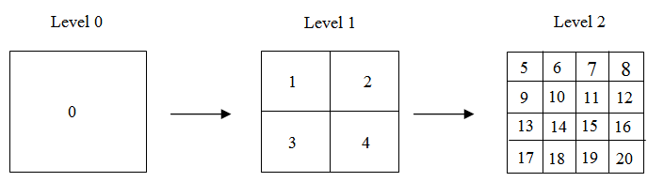
S-Tree Cell design
Can get the cell’s level and location by the number
Easy to compute

Slide 6
S-Tree storage structure
No tree structure maintained, no pointers used
Store two kinds of information in a hash table
Node relationship: parent node and child node
Object location

Slide 7
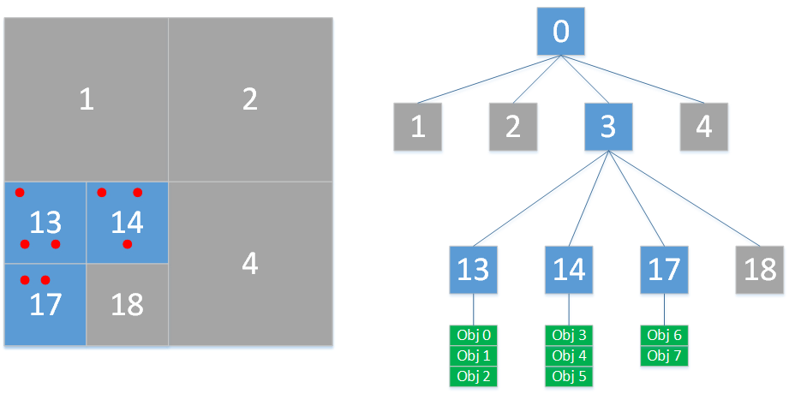
S-Tree storage structure - example

Slide 8
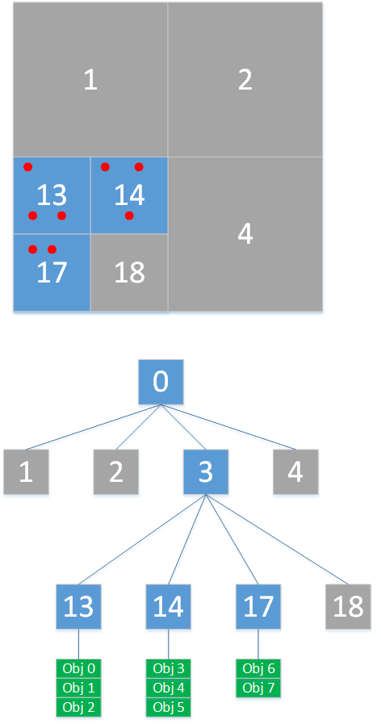
S-Tree storage structure - example
Since no tree structure is maintained, we have to store the following information instead:
Node relationship |  | Object location
Parent | Child | Node | Object
0 | 3 | 13 | Obj 0
3 | 13 | 13 | Obj 1
3 | 14 | 13 | Obj 2
3 | 17 | 14 | Obj 3
 |  | 14 | Obj 4
 |  | 14 | Obj 5
 |  | 17 | Obj 6
 |  | 17 | Obj 7

Slide 9
S-Tree storage structure - example
The information in the table in the previous slide are stored in the hash table
Key is the left column
Value is the right column
Each pair is called a fact or binary fact in the following slides

Slide 10
S-Tree Operations - Insert
Insert an object O(X,Y,ObjID) into S-Tree:
If the Level 0 is empty, choose L=0
Using hash table search, find the leaf cell that should store the point (X,Y)
Determine the number of objects N in the same cell
If N < MaxCell or L is a cell at the maximum tree level, insert the binary fact into the hash table. If N = 0, add the fact to indicate the parent-child node relationship
If N ≥ MaxCell, move all facts from the level to a set of its children cells at the level L+1 and add facts for the non-empty cells (add leaf pointers and grow S-Tree). Replace the fact with the fact (replace the leaf pointer with non-leaf pointer). Let L := L+1 and repeat from the step 1.

Slide 11
S-Tree Operations - Delete
Delete the object O(X,Y,ObjID) from S-Tree
Delete the fact
Determine the number of objects N at the cell of level L-1 that contains the cell
If N < MinCell, move all facts from the cells into (trim the S-Tree) and delete all pointers to the former leaf cells at the level L

Slide 12
S-Tree Operations - Search
Search: Given a rectangle R[X1, Y1, X2, Y2], find all objects O(X,Y, ObjID) such that
X1≤X<X2 and Y1 ≤ Y<Y2

Slide 13
S-Tree Operations - Search
Determine the maximum level L such that the searching area is in one cell
Using a hash table, try to find a fact related with the cell. If no facts found, this means that either the cell is below the tree leaf or the cell is empty. Find the largest L’ smaller than L in step 1 such that the cell is not empty
Recursively traverse S-Tree from the cell to the leaf nodes, excluding the cells that lie outside the rectangle. For each object in the leaf cells, verify that the object belongs to R[X1, Y1, X2, Y2] and return it as a query result

Slide 14
Performance
Analysis
Search
Little worse than hash table performance
O(1) < O < O(log(n))

Slide 15
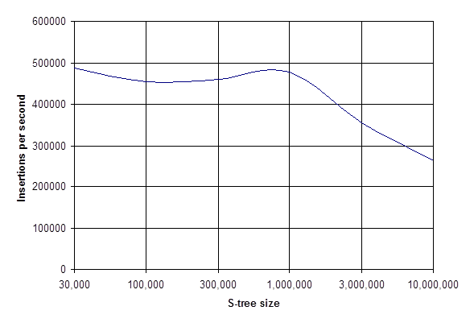
Performance

Slide 16
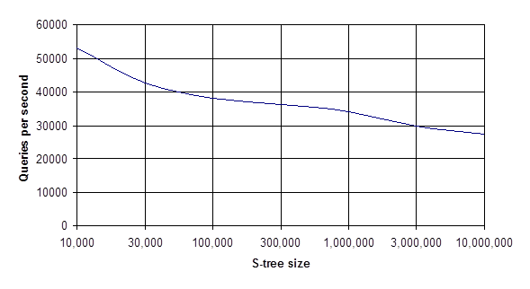
Performance

Slide 17
Services based on S-Tree
Geocoding
Address -> coordinate
Coordinate -> nearest street, city, county, etc.

Slide 18
Restrictions
Everything in RAM
Implemented in 32-bit Pascal
4GB memory limit
Too much workaround
Especially for 32-bit limit
Hard to upgrade to 64-bit even though 64-bit compiler is available now

Slide 19
Thank you

